Slide 1

BRIGHT COFFEE DATA ANALYIS
PRESENTED BY SIPHIWE MAKHUBO

Slide 2


Bright Coffee Data Analytics: Background
The flagship stores within the Bright Coffee group have become a focal point for performance evaluation. A comprehensive analysis was conducted to assess financial health, identify sales trends, and measure customer service effectiveness, with the goal of supporting data-driven decision-making across the business.
Project vision and mission
The Project Vision
To empower Bright Coffee with data-driven insights that enhance customer experiences, strengthen loyalty, and drive sustainable growth.
The Mission
Our mission is to harness data analytics to understand customer behaviors, improve service delivery, and create personalized experiences that strengthen Bright Coffee’s brand loyalty.

Slide 3
Problem Statement
Some of the Bright Coffee stores have not been performing optimally and the new CEO has tasked the data analysics team to undertake the investigation. The flagship stores within the Bright Coffee group have become a focal point for performance evaluation. A comprehensive analysis was conducted to assess financial health, identify sales trends, and measure customer service effectiveness, with the goal of supporting data-driven decision-making across the business.

Slide 4
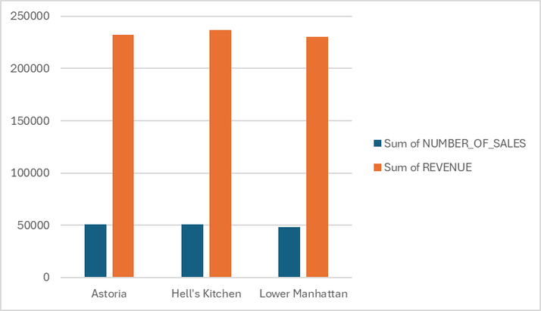
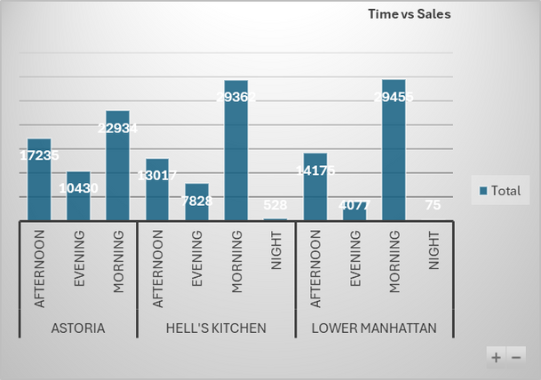
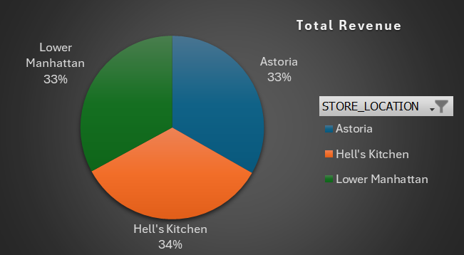
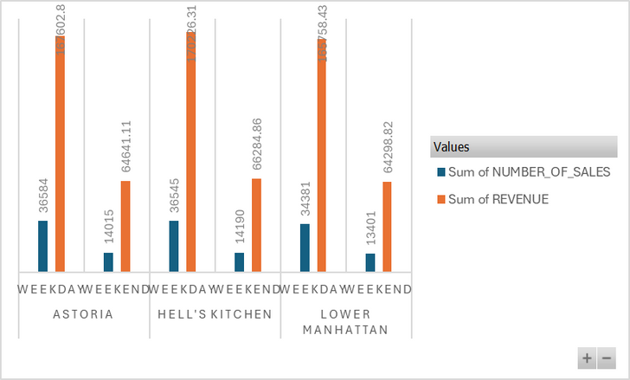
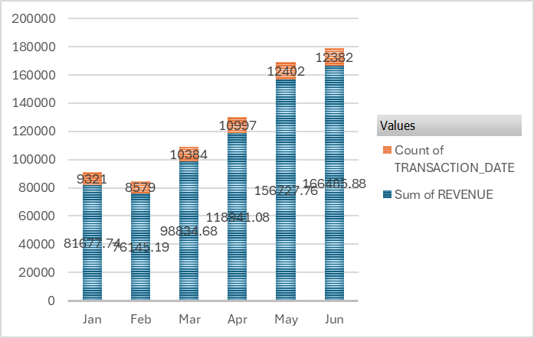
Sales & Revenue Breakdown
Times and Product Breakdown
Highest Sales & Revenue Store
Highest Sale in the Morning : Manhattan
Total Revenue
Top sales weekdays vs Weekend
Revenue vs Transactions : (6 months)

Slide 5
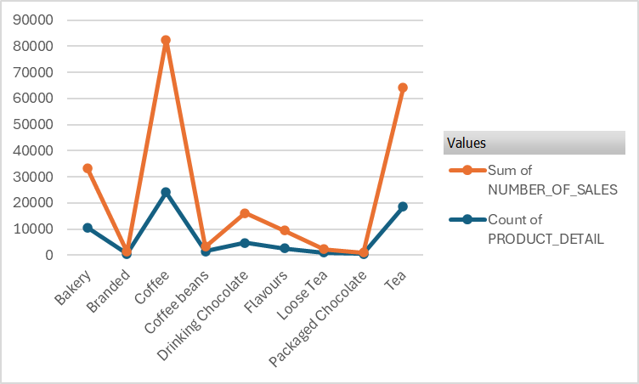
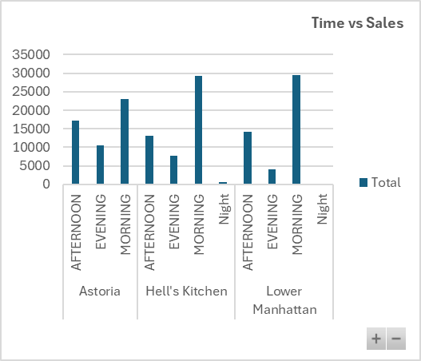
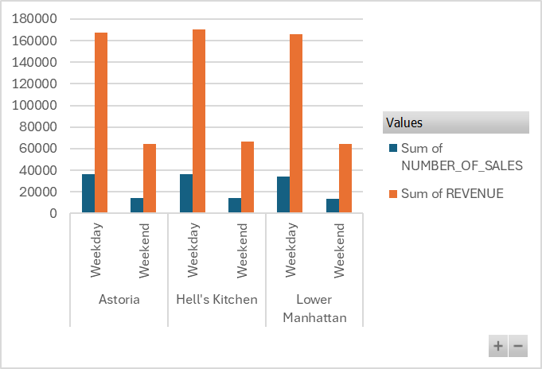
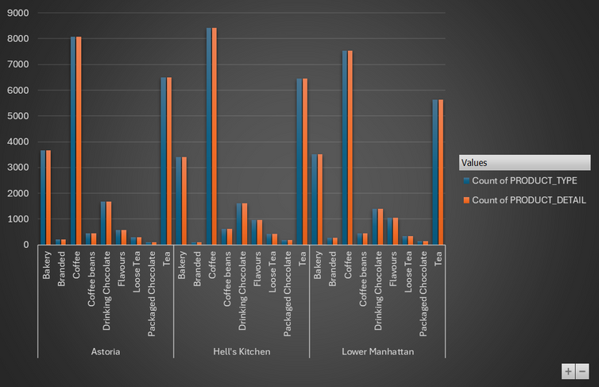
Sales & Product Breakdown
Times and Product Breakdown
Top sales for product vs Low sale
Highest Sale in the Morning : Manhattan
Top performing store Weekdays : HELL’S Kitchen
Highest selling product : Coffee in Hell’s Kitchen

Slide 6
Findings :
Findings on Underperformance
Some flagship stores are underperforming due to inconsistent sales patterns, weak weekend performance, and inefficient staffing that does not align with customer demand. Inventory management issues, including both stock shortages and waste, further reduce profitability. Customer feedback highlights service gaps in certain locations, suggesting that training and customer engagement strategies are not being applied consistently. These factors combined limit revenue growth and dilute the overall brand experience.
Findings on Performance
High-performing stores demonstrate strong and consistent sales, particularly during peak hours and weekends, supported by efficient staff allocation and proactive inventory planning. These outlets benefit from higher levels of customer satisfaction, repeat business, and better adoption of loyalty initiatives. They also show disciplined financial management, with lower costs per transaction and stronger revenue per customer, making them effective models for replication across the network

Slide 7

S.W.O.T
S
swot analysis
T
Strengths
Established flagship stores with consistent customer base.
Availability of transaction, financial, and customer service data.
Early adoption of analytics culture within the business.
Leadership support for data-driven decision-making.
Threats
Competitors adopting advanced data tools may gain an edge.
Poor data governance could lead to unreliable insights and reduced trust.
External factors (e.g., economic shifts, coffee market volatility) may impact sales.
Customer expectations for digital convenience outpacing current analytics use.
W
O
Weaknesses
Opportunities
Data gaps and missing values reduce reporting accuracy.
Inconsistent categorization (e.g., service classifications, store-level metrics).
Limited integration of analytics into daily store operations.
Heavy reliance on manual reporting in some areas
Use analytics to personalize customer experiences and boost loyalty.
Forecast demand to optimize staffing, inventory, and promotions.
Benchmark flagship store performance to identify best practices.
Expand data insights to support market growth and new store launches.

Slide 8
Turn around strategy & Recommendations
Diagnose Performance Gaps
Use data analytics to compare underperforming stores against high performers.
Identify gaps in sales trends, staffing efficiency, and customer service scores.
Pinpoint root causes such as location challenges, poor inventory control, or weak customer engagement
Reignite Customer Engagement
Introduce targeted promotions (loyalty rewards, weekend offers, seasonal specials).
Use customer feedback analytics to address pain points in service.
Enhance in-store experience with staff training focused on service excellence.
Strengthen Financial Control
Implement store-level profitability dashboards for real-time monitoring.
Reduce costs through better supplier negotiations and waste tracking.
Focus on revenue per customer and repeat purchase rates as key KPIs
Optimize Operations
Adjust staffing levels based on demand forecasts (weekday vs weekend patterns).
Improve inventory planning to reduce waste and stock-outs.
Standardize best practices from top-performing stores across the network.

Slide 9
CEO Takeaway:
Bright Coffee should focus on strengthening its data foundations by cleaning and standardizing information while automating reporting for accuracy and timeliness. Underperforming stores can be turned around by benchmarking against top performers, optimizing staffing and inventory with demand forecasts, and replicating best practices across the network. At the same time, customer experience should be enhanced through personalized promotions, improved service quality, and targeted campaigns during peak periods to boost loyalty and sales. Financial performance must be closely monitored through real-time profitability dashboards, waste reduction, and a sharper focus on revenue per customer. Finally, fostering a data-driven culture across stores will ensure managers use insights for daily decision-making, with accountability reinforced through clear targets and recognition of strong performance.

Slide 10
Thank you very much!
PRESENTED BY SIPHIWE MAKHUBO

